Slide 1
Lecture 18
Signals and Systems (ELL205)
By Dr. Abhishek Dixit
Dept. of Electrical Engineering
IIT Delhi

Slide 2
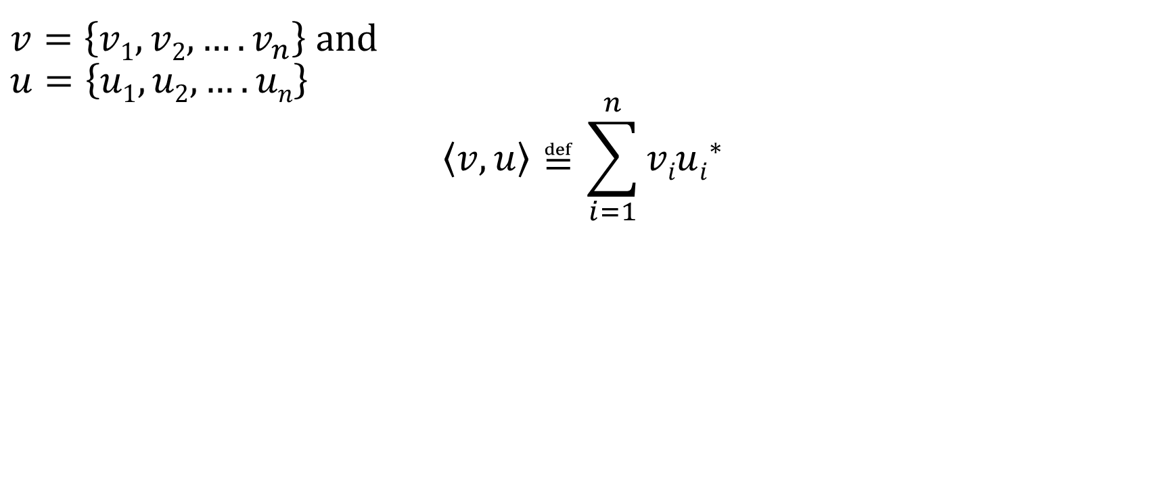
Inner Product Space
$v=\left\{v1,v2,….v_{n}\right\}$ and
$$u=\left\{u1,u2,….un\right\}$$
$$\left\langle v,u\right\rangle ≝\sum_{i=1}^{n}{viui^{∗}}$$

Slide 3
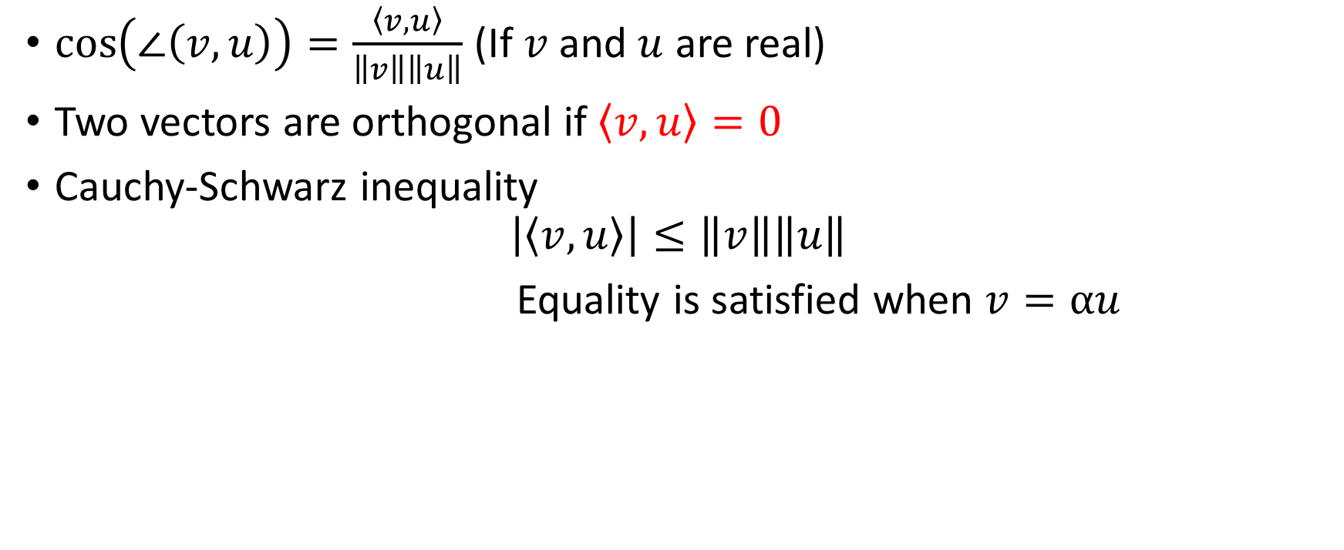
Direction
$\cos\left(∠\left(v,u\right)\right)=\frac{\left\langle v,u\right\rangle }{\left\|v\right\|\left\|u\right\|}$ (If $v$ and $u$ are real)
Two vectors are orthogonal if $\left\langle v,u\right\rangle =0$
Cauchy-Schwarz inequality
$$\left|\left\langle v,u\right\rangle \right|≤\left\|v\right\|\left\|u\right\|$$
Equality is satisfied when $v=αu$

Slide 4
Outline
Introduction to vectors
Introduction to inner product and projection theorem
Introduction to signals as vectors

Slide 5
ℒ₂ space is a vector space
ℒ₂ space is a vector space

Slide 6
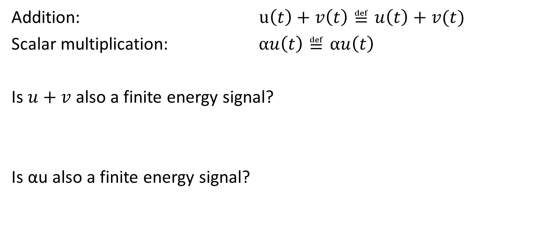
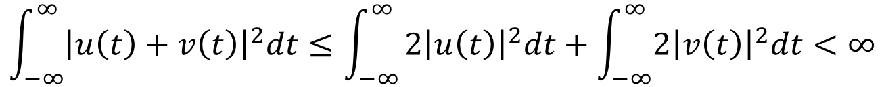
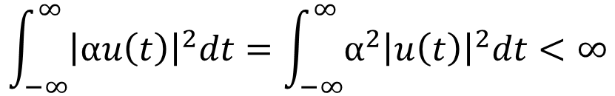
Is ℒ₂ space a vector space?
Addition: $u\left(t\right)+v\left(t\right)≝u\left(t\right)+v(t)$
Scalar multiplication: $αu\left(t\right)≝αu\left(t\right)$
Is $u+v$ also a finite energy signal?
Is αu also a finite energy signal?
$$\int_{−∞}^{∞}{{\left|u\left(t\right)+v\left(t\right)\right|}^{2}dt≤\int_{−∞}^{∞}{{2\left|u\left(t\right)\right|}^{2}dt+\int_{−∞}^{∞}{2{\left|v\left(t\right)\right|}^{2}dt<∞}}}$$
$$\int_{−∞}^{∞}{{\left|αu\left(t\right)\right|}^{2}dt=\int_{−∞}^{∞}{{α^{2}\left|u\left(t\right)\right|}^{2}dt<∞}}$$

Slide 7
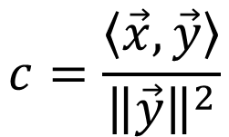


Minimum error in approximation
$$\vec{e}$$
$$\vec{e}$$
θ
90º
c
$$c=\frac{\left\langle \vec{x}, \vec{y}\right\rangle }{{\left\|\vec{y}\right\|}^{2}}$$

Slide 8
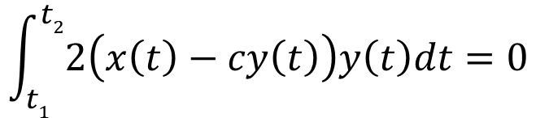
Minimum error in approximation in real signals
Estimating x in terms of y
Defining error signal
and its energy
$$\int_{t1}^{t2}{2\left(x\left(t\right)−cy\left(t\right)\right)y\left(t\right)dt=0}$$
Differentiating energy
to get
From above we calculate c as:

Slide 9
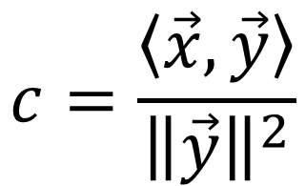
Equivalence of vectors and real signals
$$c=\frac{\left\langle \vec{x}, \vec{y}\right\rangle }{{\left\|\vec{y}\right\|}^{2}}$$
$$\left\langle \vec{x}, \vec{y}\right\rangle =\int_{t1}^{t2}{x\left(t\right)y\left(t\right)dt}$$
$${\left\|\vec{y}\right\|}^{2}=\int_{t1}^{t2}{y^{2}\left(t\right)dt}$$

Slide 10
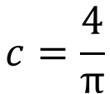

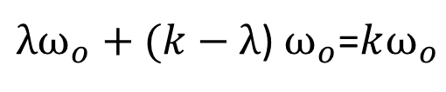
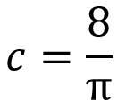
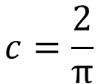
Try it yourself !!
1
-1
$$x\left(t\right)=csint$$
0 π 2π
What is c for minimum error?
1) | 2)
3) | 4)
$$c=\frac{4}{π}$$
$$c=\frac{2}{π}$$
$$c=\frac{1}{π}$$
$$c=\frac{8}{π}$$

Slide 11
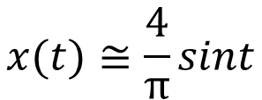
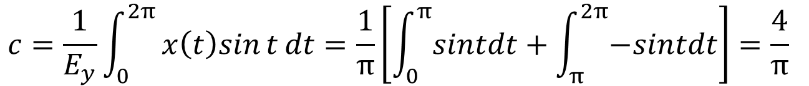
Finding c
$$y\left(t\right)=sint$$
$$Ey=\int_{0}^{2π}{\sin^{2}{t}dt=π }$$
$$c=\frac{1}{E_{y}}\int_{0}^{2π}{x\left(t\right)sin{t}dt=\frac{1}{π}\left[\int_{0}^{π}{sintdt}+\int_{π}^{2π}{−sintdt}\right]=\frac{4}{π} }$$
$$x(t)≅\frac{4}{π}sint$$

Slide 12
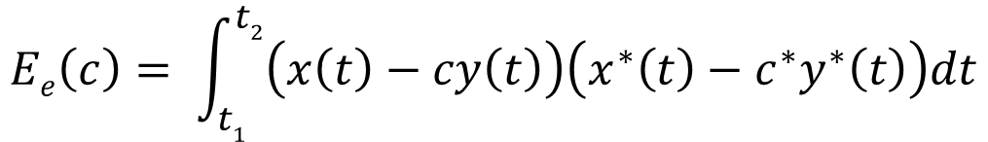
Minimum error in approximation in complex signals
Estimating x in terms of y
Defining error signal
and its energy
Algebraic workout:
$$Ee\left(c\right)= \int_{t1}^{t2}{\left(x\left(t\right)−cy\left(t\right)\right)\left(x^{∗}\left(t\right)−c^{∗}y^{∗}\left(t\right)\right)dt}$$
$$Ee\left(c\right)=\int_{t1}^{t2}{\left(x\left(t\right)x^{∗}\left(t\right)−cy\left(t\right)x^{∗}\left(t\right)−c^{∗}x\left(t\right)y^{∗}\left(t\right)+{\left|c\right|}^{2}y\left(t\right)y^{∗}\left(t\right)\right)dt}$$

Slide 13
Minimum error in approximation in complex signals
$$Ee\left(c\right)=\int_{t1}^{t2}{\left(x\left(t\right)x^{∗}\left(t\right)−cy\left(t\right)x^{∗}\left(t\right)−c^{∗}x\left(t\right)y^{∗}\left(t\right)+{\left|c\right|}^{2}y\left(t\right)y^{∗}\left(t\right)\right)dt}$$
$$Ee\left(c\right)=\int_{t1}^{t2}{{\left|x\left(t\right)\right|}^{2}dt}+{\left|c\sqrt{Ey}−\frac{1}{\sqrt{Ey}}\int_{t1}^{t2}{x\left(t\right)y^{∗}\left(t\right)dt}\right|}^{2}$$

Slide 14
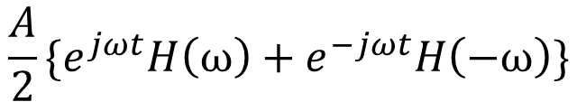

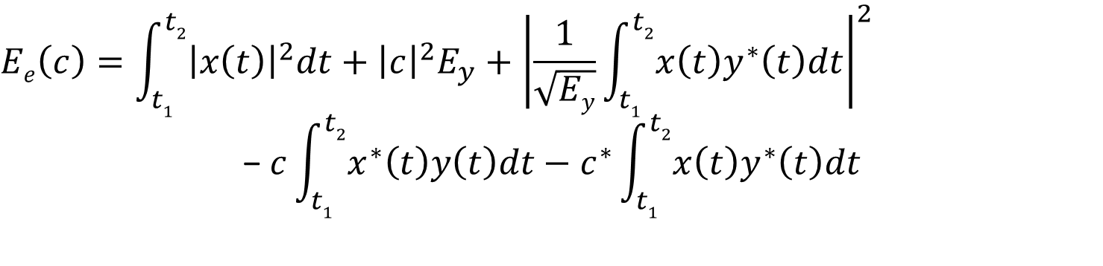


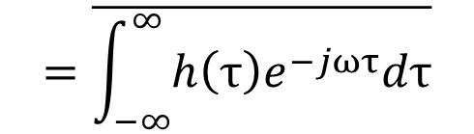
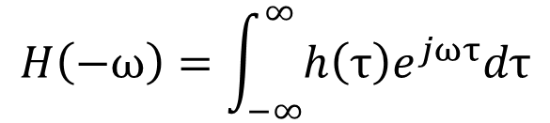
Minimum error in approximation in complex signals
$$Ee\left(c\right)=\int_{t1}^{t2}{\left(x\left(t\right)x^{∗}\left(t\right)−cy\left(t\right)x^{∗}\left(t\right)−c^{∗}x\left(t\right)y^{∗}\left(t\right)+{\left|c\right|}^{2}y\left(t\right)y^{∗}\left(t\right)\right)dt}$$
$${\left|a−b\right|}^{2}={\left|a\right|}^{2}+{\left|b\right|}^{2}−ab^{∗}{−a}^{∗}b$$
$$Ee\left(c\right)=\int_{t1}^{t2}{{\left|x\left(t\right)\right|}^{2}dt}+{\left|c\sqrt{Ey}−\frac{1}{\sqrt{Ey}}\int_{t1}^{t2}{x\left(t\right)y^{∗}\left(t\right)dt}\right|}^{2}$$
$$a$$
$$b$$
$$Ee\left(c\right)=\int_{t1}^{t2}{{\left|x\left(t\right)\right|}^{2}dt}+{\left|c\right|}^{2}E_{y}+{\left|\frac{1}{\sqrt{Ey}}\int_{t1}^{t2}{x\left(t\right)y^{∗}\left(t\right)dt}\right|}^{2}$$
$$\text{−} c\int_{t1}^{t2}{x^{∗}\left(t\right)y\left(t\right)dt}−c^{∗}\int_{t1}^{t2}{x\left(t\right)y^{∗}\left(t\right)dt}$$
$${\left|a\right|}^{2}$$
$${\left|b\right|}^{2}$$
$$ab^{∗}$$
$$a^{∗}b$$

Slide 15
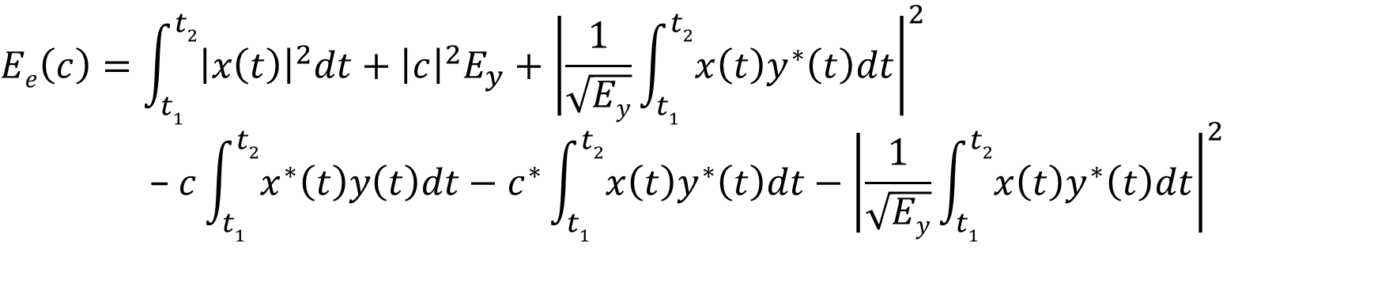
Minimum error in approximation in complex signals
$$Ee\left(c\right)=\int_{t1}^{t2}{\left(x\left(t\right)x^{∗}\left(t\right)−cy\left(t\right)x^{∗}\left(t\right)−c^{∗}x\left(t\right)y^{∗}\left(t\right)+{\left|c\right|}^{2}y\left(t\right)y^{∗}\left(t\right)\right)dt}$$
$$Ee\left(c\right)=\int_{t1}^{t2}{{\left|x\left(t\right)\right|}^{2}dt}+{\left|c\sqrt{Ey}−\frac{1}{\sqrt{Ey}}\int_{t1}^{t2}{x\left(t\right)y^{∗}\left(t\right)dt}\right|}^{2}−{\left|\frac{1}{\sqrt{Ey}}\int_{t1}^{t2}{x\left(t\right)y^{∗}\left(t\right)dt}\right|}^{2}$$
$$Ee\left(c\right)=\int_{t1}^{t2}{{\left|x\left(t\right)\right|}^{2}dt}+{\left|c\right|}^{2}E_{y}+{\left|\frac{1}{\sqrt{Ey}}\int_{t1}^{t2}{x\left(t\right)y^{∗}\left(t\right)dt}\right|}^{2}$$
$$\text{−} c\int_{t1}^{t2}{x^{∗}\left(t\right)y\left(t\right)dt}−c^{∗}\int_{t1}^{t2}{x\left(t\right)y^{∗}\left(t\right)dt}−{\left|\frac{1}{\sqrt{Ey}}\int_{t1}^{t2}{x\left(t\right)y^{∗}\left(t\right)dt}\right|}^{2}$$

Slide 16
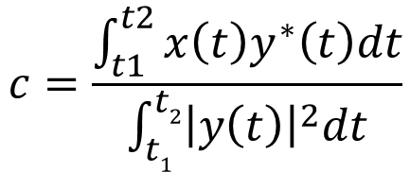
Minimum error in approximation in complex signals
$$Ee\left(c\right)=\int_{t1}^{t2}{{\left|x\left(t\right)\right|}^{2}dt}−{\left|\frac{1}{\sqrt{Ey}}\int_{t1}^{t2}{x\left(t\right)y^{∗}\left(t\right)dt}\right|}^{2}+{\left|c\sqrt{Ey}−\frac{1}{\sqrt{Ey}}\int_{t1}^{t2}{x\left(t\right)y^{∗}\left(t\right)dt}\right|}^{2}$$
$$c=\frac{\int_{t1}^{t2}{x\left(t\right)y^{∗}\left(t\right)dt}}{\int_{t1}^{t2}{{\left|y\left(t\right)\right|}^{2}dt}}$$

Slide 17
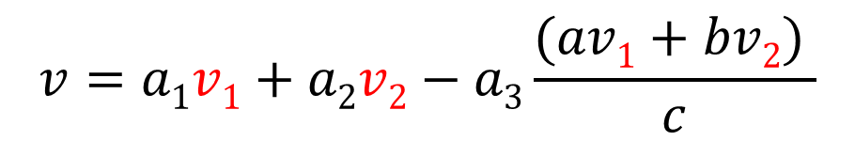
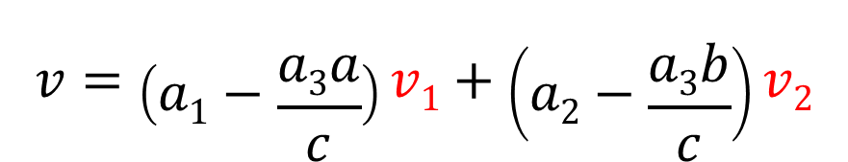

Equivalence of vectors and complex signals
$$c=\frac{\int_{t1}^{t2}{x\left(t\right)y^{∗}\left(t\right)dt}}{\int_{t1}^{t2}{{\left|y\left(t\right)\right|}^{2}dt}}$$
$$c=\frac{\left\langle \vec{x}, \vec{y}\right\rangle }{{\left\|\vec{y}\right\|}^{2}}$$
$$\left\langle \vec{x}, \vec{y}\right\rangle =\int_{t1}^{t2}{x\left(t\right)y^{∗}\left(t\right)dt}$$
$${\left\|\vec{y}\right\|}^{2}=\int_{t1}^{t2}{{\left|y\left(t\right)\right|}^{2}dt}$$

Slide 18
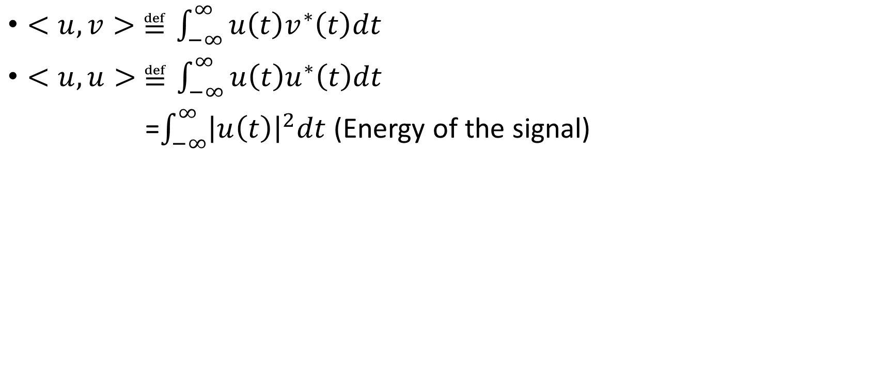
The Inner Product space of ℒ₂ waveforms
$<u,v> ≝\int_{−∞}^{∞}{u\left(t\right)v^{∗}\left(t\right)dt}$
$<u,u> ≝\int_{−∞}^{∞}{u\left(t\right)u^{∗}\left(t\right)dt}$
=$\int_{−∞}^{∞}{{\left|u\left(t\right)\right|}^{2}dt}$ (Energy of the signal)

Slide 19
Properties of Inner Product
a) Hermitian symmetry: $\left\langle v,u\right\rangle ={\left\langle u,v\right\rangle }^{∗}$
Proof: $\left\langle u,v\right\rangle ≝\int_{−∞}^{∞}{u\left(t\right)v^{∗}\left(t\right)dt}$
$${\left\langle u,v\right\rangle }^{∗}={\left(\int_{−∞}^{∞}{u\left(t\right)v^{∗}\left(t\right)dt}\right)}^{∗}=\int_{−∞}^{∞}{u^{∗}\left(t\right)v\left(t\right)dt}=\left\langle v,u\right\rangle$$
b) Hermitian bilinearity: $\left\langle αv+βu,w\right\rangle =α\left\langle v,w\right\rangle + β\left\langle u,w\right\rangle$
$\left\langle v,αu+βw\right\rangle =α^{∗}\left\langle v,u\right\rangle +β^{∗}\left\langle v,w\right\rangle$

Slide 20
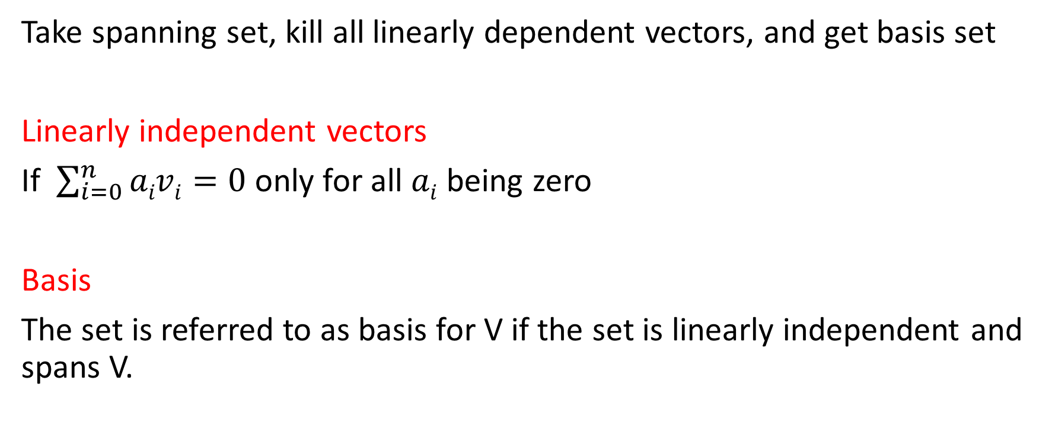
Properties of Inner Product
c) Strict positivity: $\left\langle v,v\right\rangle ≥0$ with equality if and only if $v=0$
$\int_{−∞}^{∞}{{\left|v\left(t\right)\right|}^{2}dt=0}$ if $v≠0$ Axiom is not satisfied !!

Slide 21
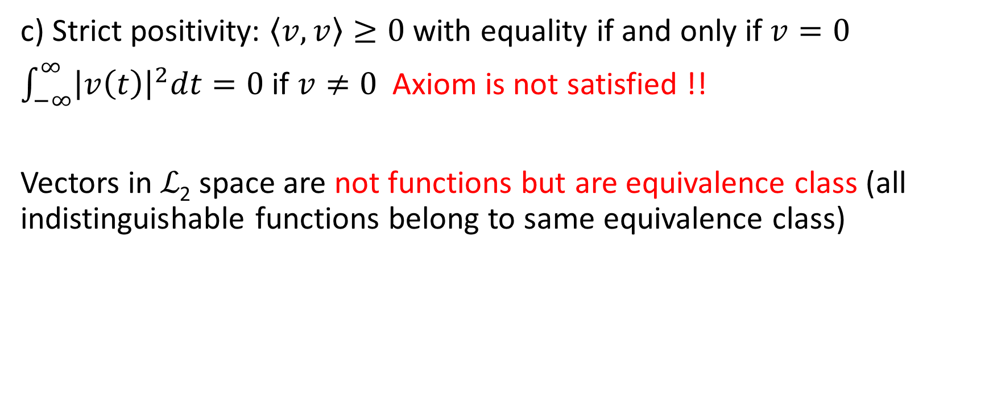
Properties of Inner Product
c) Strict positivity: $\left\langle v,v\right\rangle ≥0$ with equality if and only if $v=0$
$\int_{−∞}^{∞}{{\left|v\left(t\right)\right|}^{2}dt=0}$ if $v≠0$ Axiom is not satisfied !!
Vectors in ℒ₂ space are not functions but are equivalence class (all indistinguishable functions belong to same equivalence class)

Slide 22
Outline
Introduction to vectors
Introduction to inner product and projection theorem
Introduction to signals as vectors
Signal spaces

Slide 23
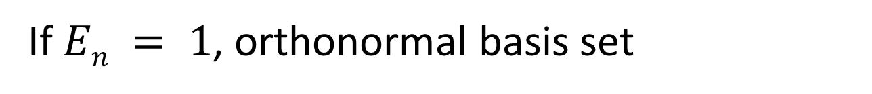
Signal Orthogonal Vector Space
If $En = 1$, orthonormal basis set

Slide 24
Error in approximation
For minimum error c_{n} is

Slide 25
What can we choose as basis vectors?
Complex Exponentials
Walsh functions, e.g., CDMA applications
Legendre Polynomials, e.g., spherical geometries
Laugerre functions, e.g., data compression
Hermite Polynomials, e.g., interpolation
Bessel functions, optical fiber communication (cylindrical geometries)
Chebyshev Polynomials, e.g., filter designing
Jacobi Polynomials, e.g., data compression and filter designing

